Slide 1
Kubernetes StatefulSet
What is StatefulSet?
Why StatefulSet is used?
How StatefulSet works and how its different from Deployment?
https://kubernetes.io/docs/concepts/workloads/controllers/statefulset/

Slide 2
StatefulSet for stateful applications
Stateful applications
Stateless applications
Examples of stateful applications:
- Databases
- applications that tracking state
Don’t keep record of state
Each request is completely new, isolated interaction based on the information that comes with it (e.g. deployment)

Slide 3
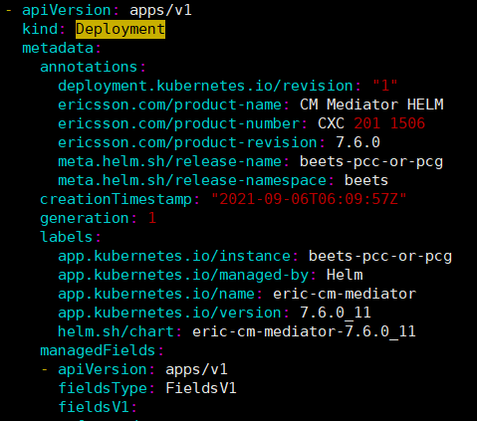
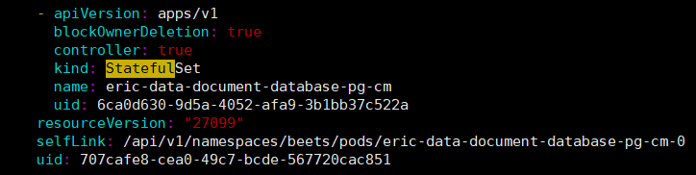
Stateless applications
Stateful applications
Deployed using kind Deployment
Deployed using kind StatefulSet

Slide 4
Deployment vs StatefulSet
Replicating stateful application is more difficult
Other differences:
For deployement
Identical and interchangeable
Created/deleted in random order with random hashes
One Service that load balances to any pod
svc
App-a331p
App-b434c
App-c342v
Notes:
kubectl scale deployment nginx-deployment --replicas 10

Slide 5
For StatefulSet
Cant be randomly addressed
Cant be created/deleted at same time
The replica pods are not identical, StatefulSet hold sticky identity towards each replica
Created from save specification but not interchangeable
Persistent identifier across in a re-scheduling (fixed ordered name)
svc
svc
Pod dies
Be replaced by new pod
App-id01
App-id02
App-id03
App-id01
App-id02
App-id03
Notes:
The pod will be created in order, like if id01 (master) created failed, id02 won’t be created. And reverse order for deletion or scale down
The new pod keep the original replica identifier

Slide 6
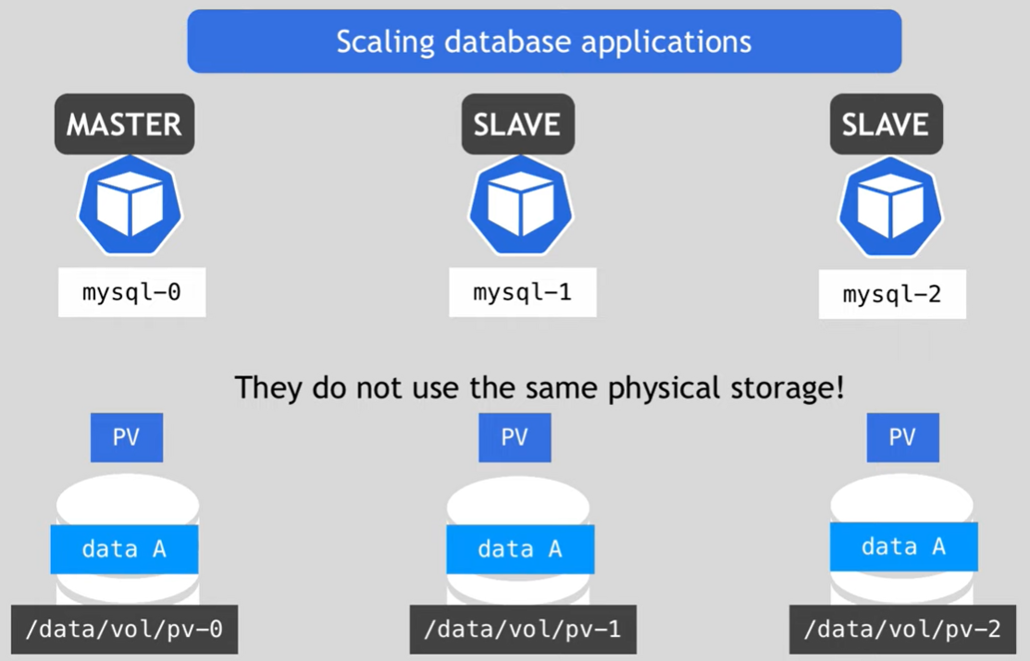
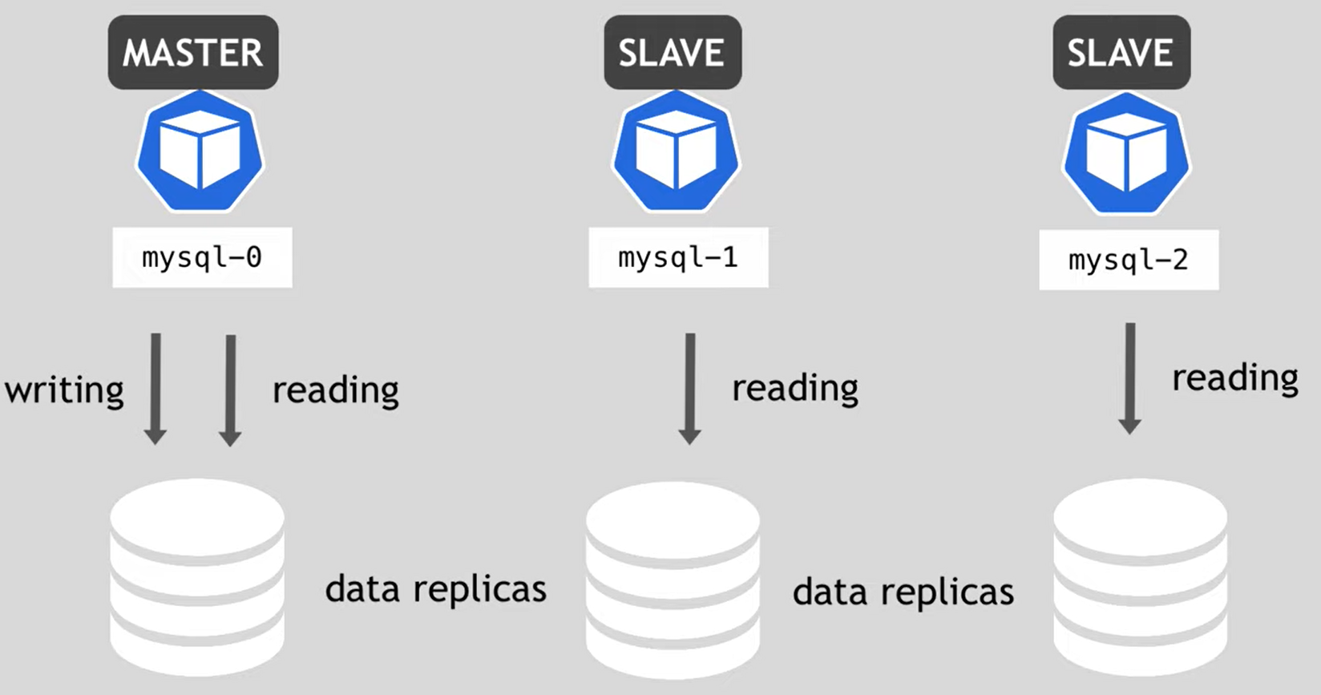
Notes:
Data consistency, the master and slave pods have to continuously synchronize

Slide 7
Pod restart -> ip changes, but name and endpoints will stay same
Fixed Individual dns endpoint service name ($podName + $serviceDomain)
App-id01
.svc2
App-id02
.svc2
App-id03
.svc2
App-id01
App-id02
App-id03
svc1
Loadbalancer
Notes:
Pods get sticky identities ->retain state & its role when recover after pod dies
Get their own dns endpoint from the services

Slide 8
